Slide 1

H172 35 - Object Oriented Analysis and Design
Detailed Class Diagrams

Slide 2
Two Stage Approach to Diagram
Initial Class Diagram:
All Classes identified
All Relationship types (inheritance, association, aggregation, composition)
Multiplicity (where useful)
Detailed Class Diagram:
All attributes (with data types)
All methods (with return types + parameters)
Visibility of attributes + methods

Slide 3
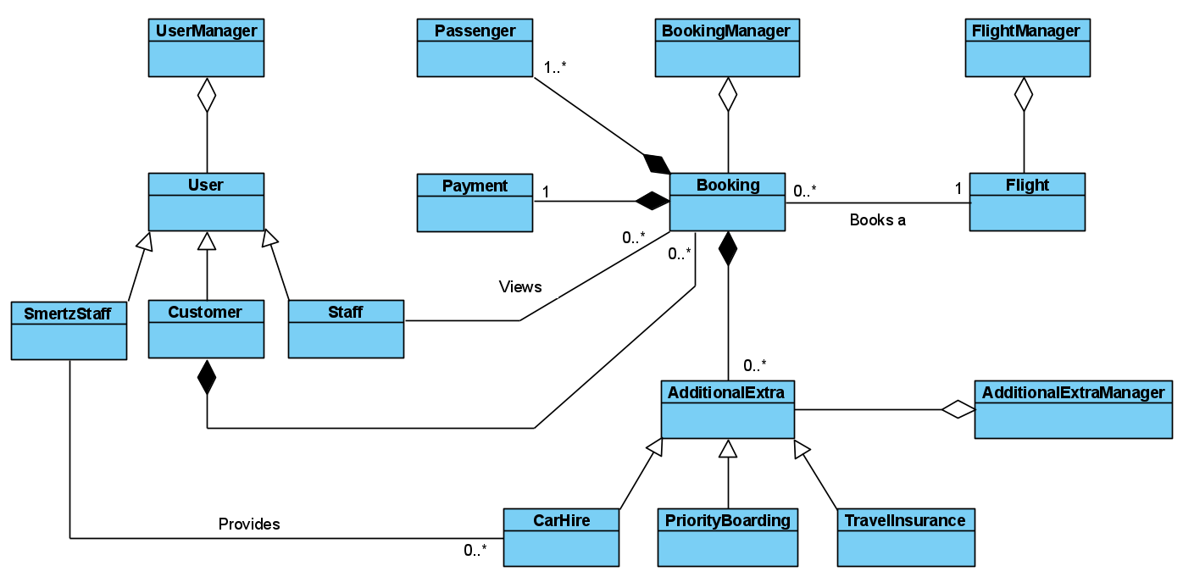

Slide 4
Detailed Class Diagram

Slide 5
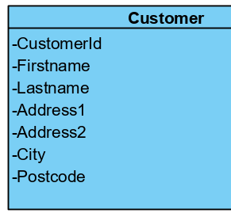
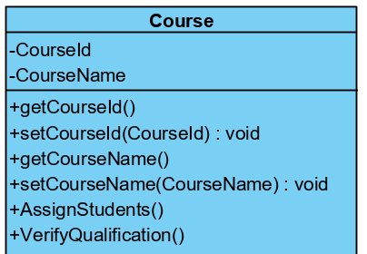
Visibility of Attributes & Methods
Private (-) : Only accessible within the class itself
Public (+) : Accessible to all code – no restrictions
In general:
Attributes have:
A private variable
A public Getter method
A public Setter method
Methods are:
Almost always public

Slide 6
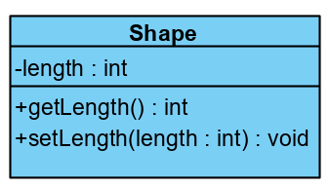
Attributes
Attributes appear in the top half of a class box
The visibility of the attribute (private / public) comes first
Then the name of the attribute
Followed by a colon
And then the data type
Every attribute in our design will also have:
Getter method
Setter method

Slide 7
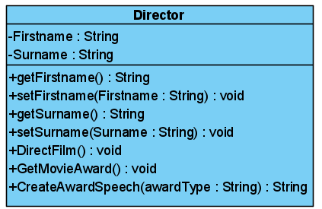
Methods / Functions
Methods appear in the bottom half of a class box
The visibility of the method (private / public) comes first
Then the name of the method
Followed by a brackets
Inside the brackets you provide any input parameters if required
Followed by a colon
And then the methods return data type (or void if it doesn’t return anything)

Slide 8
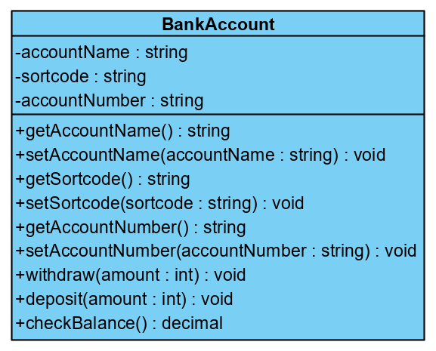
Detailed Class Example
Class Name
Attributes
Data types are defined
Getters and Setters
Getters return values and have no parameters
Setters are void and have one parameter
Other Class Operations

